Slide 1

CS8611 - Mini Project
22nd JUNE 2022

Slide 2
INSURANCE MANAGEMENT SYSTEM
KALAIYARASAN V 811219104007
YATHESH M 811219104026
Project Supervisor
prof. G.Revathi
Professor/Computer Science & Engineering
Indra Ganesan college of Engineering

Slide 3
CONTENTS
OBJECTIVE
INDRODUCTION
EXISITING SYSTEM
PROPOSED SYSTEM
H/W AND S/W REQUIREMENTS
SCREENSHOTS
CONCLUTION

Slide 4
OBJECTIVE
The main goal of the researchers is to design, develop and implement an Insurance Management System that will support the day-to-day operations of insurance agencies and automate management processes.
Specifically, the researchers aim the following objectives:
To introduce a platform that will automate insurance agency’s marketing.
To simplify and ease up insurance agency’s data management.
To introduce electronic encoding of policy form and customer data.
To evaluate the system in terms of user acceptability, effectiveness, quality, productivity, and reliability.

Slide 5
INDRODUCTION
An online insurance management system is a web program that tracks the specifics of an insurance policy, as well as customer and company information. This website is an online insurance analysis and information management system that makes it simple to find information about insurance individuals and resources.
When a user logs in to the Policy Holder module, they can see their own personal information. This project can be used by any insurance company to handle insurance details, sanction insurance for customers, process insurance policy details, and conduct all types of insurance processes online. The Insurance Management System is a full-featured solution for businesses that need to manage insurance for their vehicles, equipment, buildings, and other assets.

Slide 6
EXISITING SYSTEM
In the existing Insurance Management System, the work is done by hand. All the details for the insurance such as cash information or age related important information was collected into the hard copy and by chance if any of the document get missed up or get harmed then whole of the information will be missed, resulted into the major loss for the user.
Also adding all the details manually will take a lot of time and also a lot more chances of entering the information wrong. And also sending details from one place to another will not be any task because in case while sending one important document from one place to another, it get lost, then also it will proved to a great loss both for the user as well as for the organization

Slide 7
DISADVANTAGES
• It is time taking process. There is no online Insurance management facility in this system. There is no rich user interface. • There is very less security for saving data; some data may be loss due to mismanagement. • In this system there is no report generation. • It’s a limited system and fewer users friendly. • In this system users cannot able to restrict the information.

Slide 8
PROPOSED SYSTEM
The actual process of the organization can be modularized into three different independent views 1. Customer view 2. Policy holders view 3. System administrators view The Agent at any time can view the required information whether it is policies, or customers at the click of a mouse and instance of a second. If planned in an organized manner the customers can be provided an online terminal. The customers or policyholder’s reminders can be generated at speed just by query for the specific customers.

Slide 9
ADVANTAGES
Our insurance management system is very useful to customers in providing more information about all insurance companies and their policies that are uniquely launched in our website. • The system reduces manual work during registration of policies. • This system also provides online payments for the customers.

Slide 10
H/W AND S/W REQUIREMENTS
SOFTWARE REQUIREMENTS
Operating system : Windows 10 OS
Front End : HTML, CSS, Bootstrap, JavaScript
Back End : SQLite
Framework : Django
HARDWARE REQUIREMENTS
Processor : Intel Core i5
RAM : 4 GB
Hard disk : 500 GB

Slide 11
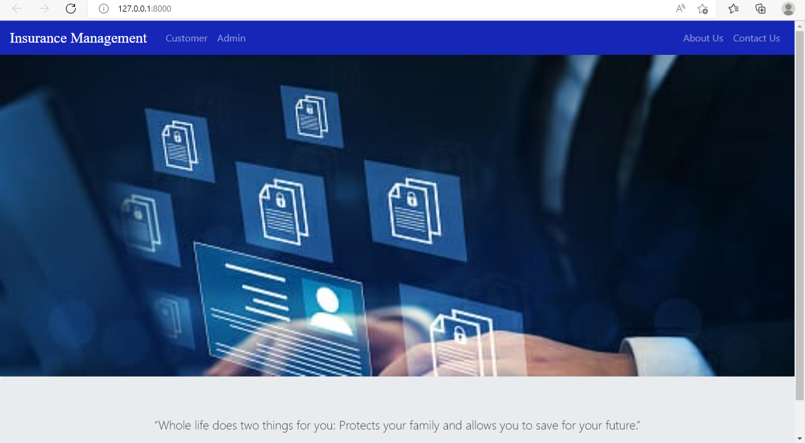
SCREENSHOTS
HOME PAGE:

Slide 12
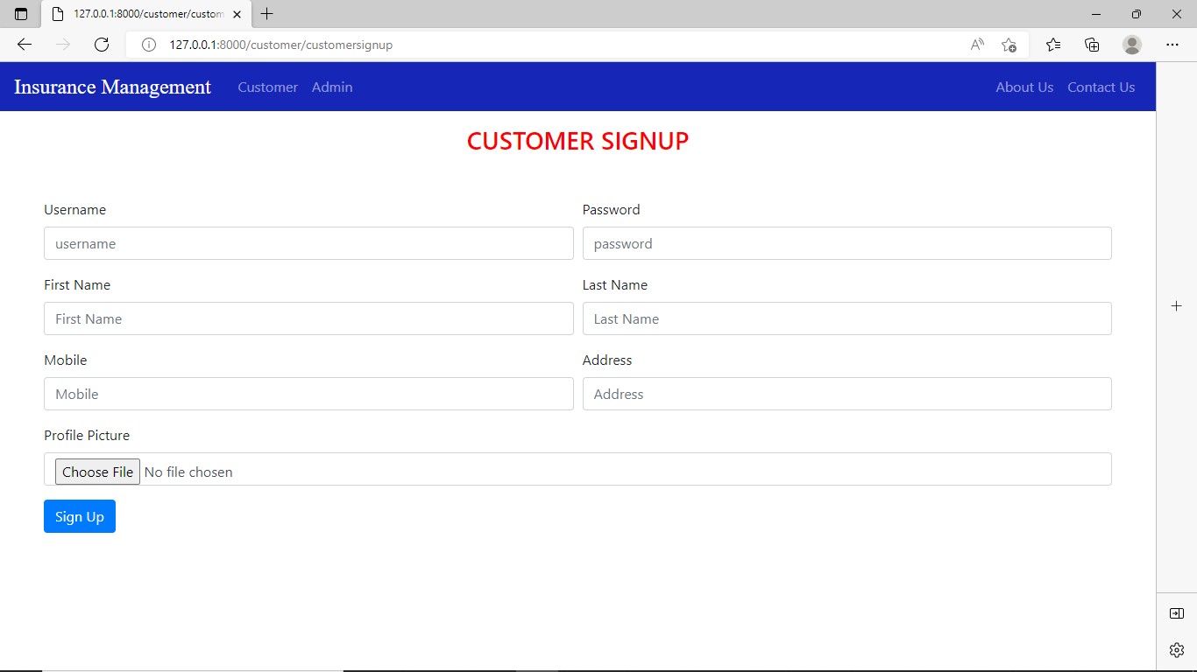
Customer Register:

Slide 13
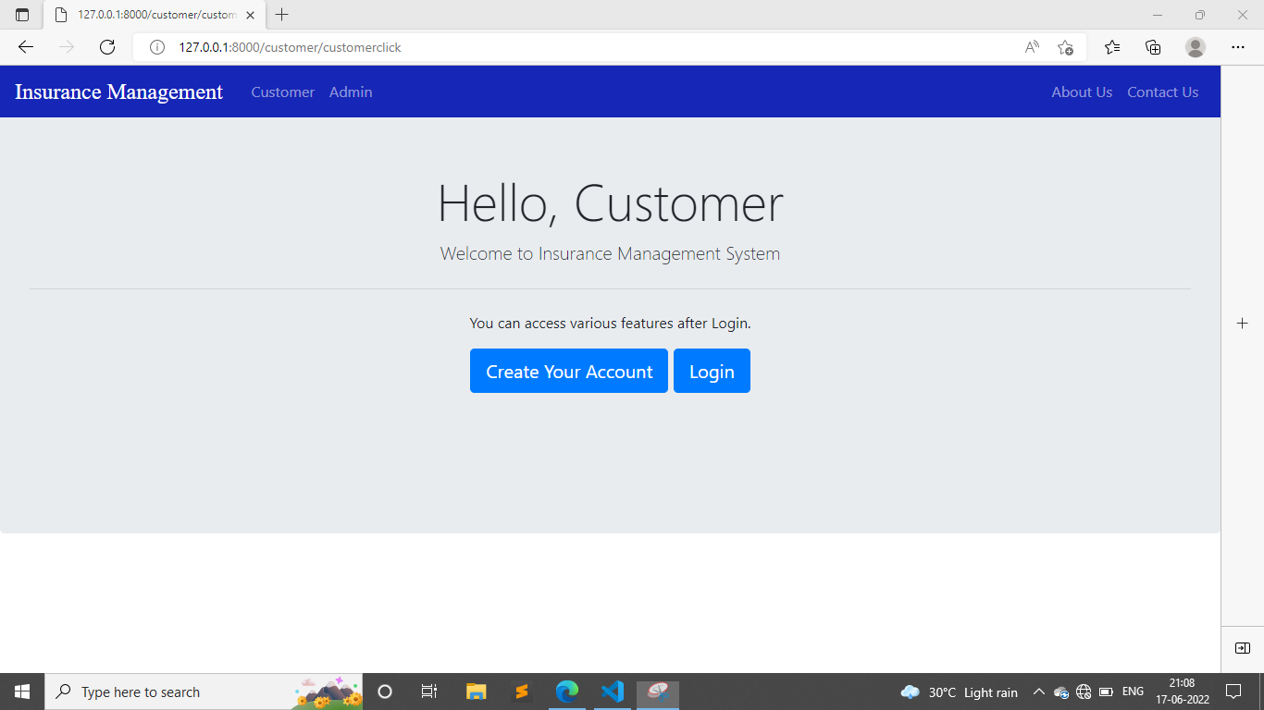
CUSTOMER LOGIN:

Slide 14
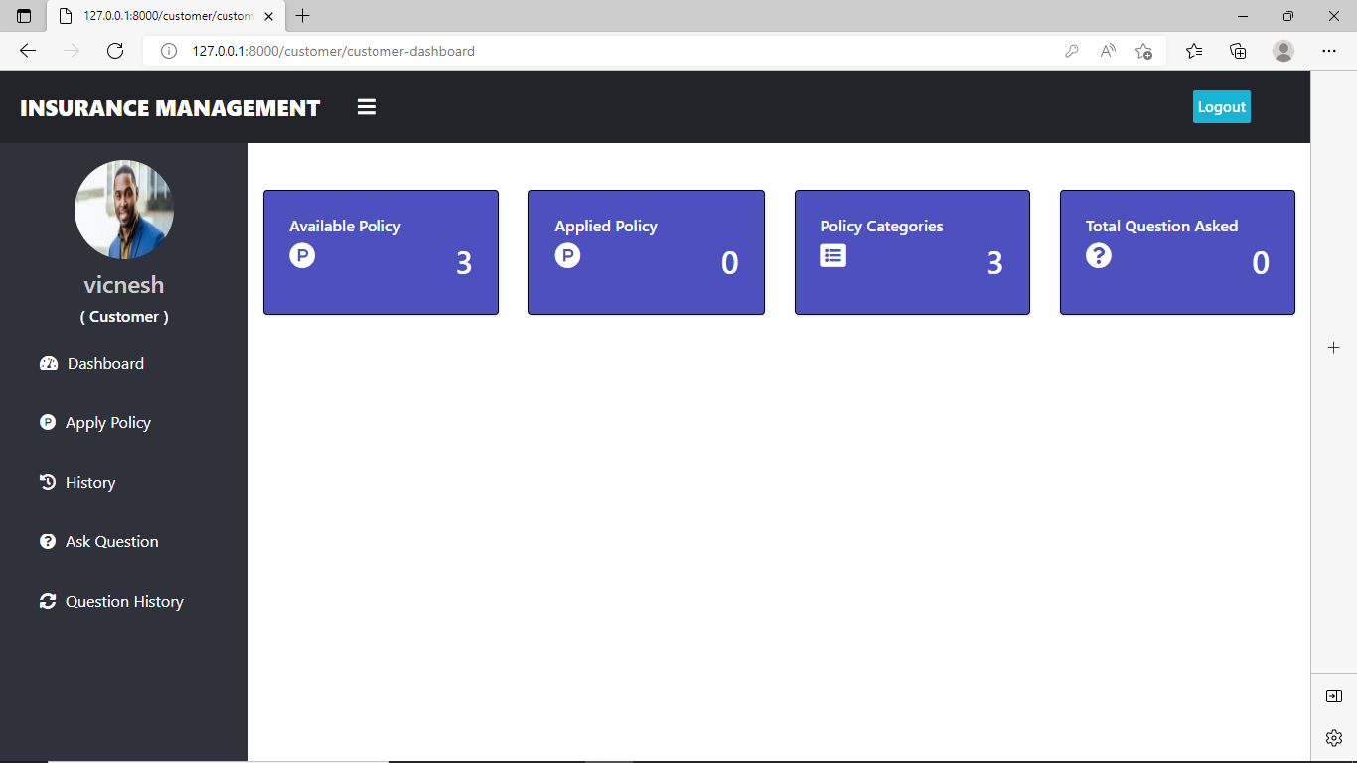
Customer Page:

Slide 15
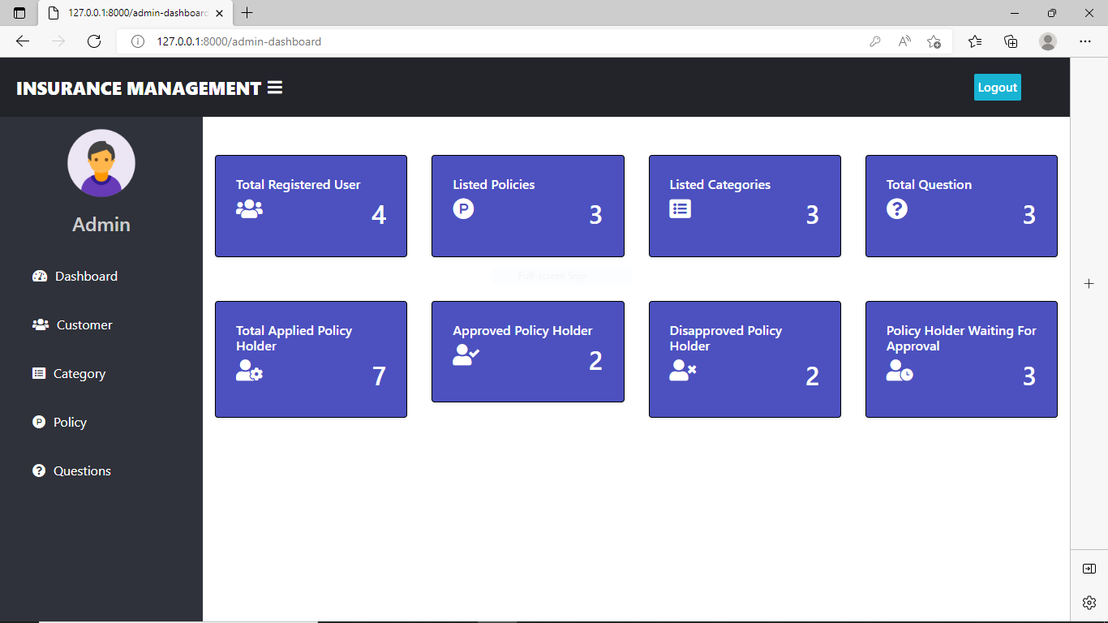
Admin Page:

Slide 16
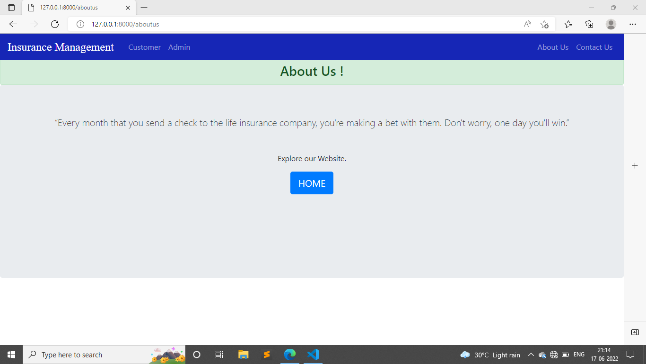
About Page:

Slide 17
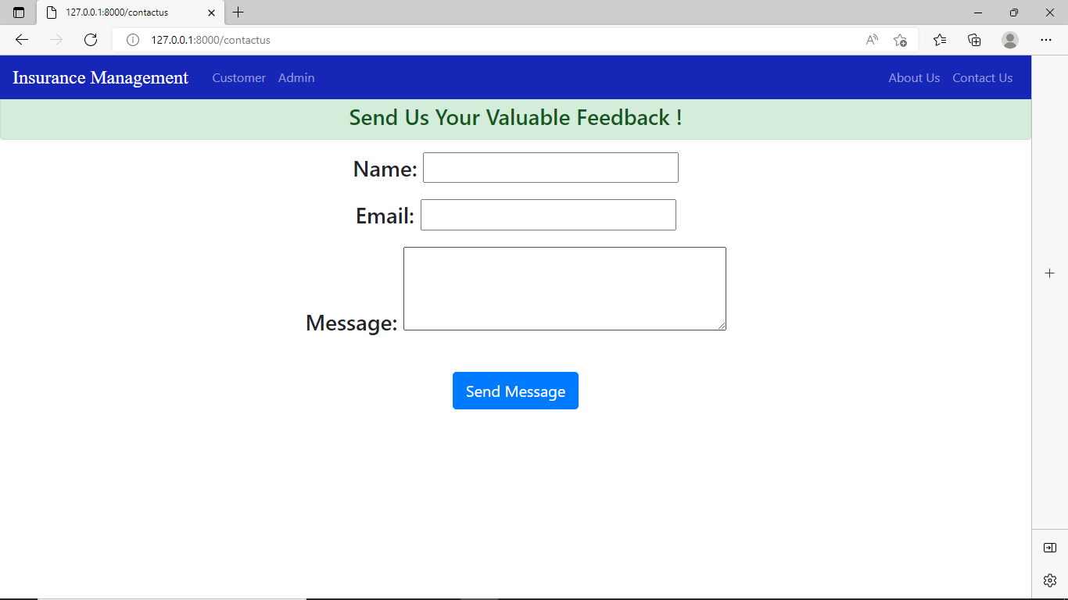
Contact Us:

Slide 18
CONCLUTION
The developed project fulfills the website facilities estimated for pahse-1
development and as per all the currently addressed requirements of the client(stakeholder.
Development team will provide
Uploading and trail running of the website.
Plan to avoid/handle unexpected damages
Probable list of modifications that will guide the pahse-2 development of the project.

Slide 19
FUTURE ENHANCEMENT
The Future Scope of the work is Insurance Management System. We can enhance this system by including more facilities like Insurace system for the policy details of Category in the Insurance.Providing such features enable the users to include more comments into the system.

Slide 20
REFERENCE
www.w3schools.com
www.php.net
en.wikipedia.org/wiki/PHP
www.hotscripts.com/category/php
www.mysql.com

